Slide 1

Not-at-Fault Damage Recovery Program
For Dealerships
P r e p a r e d B y :
YOUR NAME
Alternative Claims Management
@altclaim.com

Slide 2
How We Help
ACM specializes in nationwide recovery for loaner, rental and specialty fleet vehicles, including EMS, police, fire, construction, trucking, utilities, buses, trade services, and more. We secure more complete recoveries for not-at-fault accident claims, including repairs, loss of use, diminished value, damaged and total losses – funds rightfully yours.
Key Advantages:
More complete recovery
Not a budgetary add; no upfront costs or risks
Huge labor savings for your staff; recover valuable time for more important tasks
Claims audit for the past 2-6 years (based on state statute)
Advance program for accelerated cash flow
28 years of specialized expertise; no one else comes close to ACM success
Claim Line Items We Recover:
Physical Damage (PD): Recovery of losses up to the value of the Client’s final repair invoice or original body or mechanical shop estimate.
Physical Damage (PS) – Photoscopes Only. ACM may accept clear photographs from which an independent, third-party appraiser can prepare an estimate. This reduces Client’s downtime, labor associated with estimate collection, and keeps fleet vehicles in service.
Loss of Use (LOU): The rental value of a comparable replacement vehicle or equipment for the days the unit is anticipated to be out of service for repair or replacement.
Loss of Revenue (LOR): The estimated loss of income while the vehicle is out of service.
Inherent Diminution of Value (DV): The estimated variance of the vehicle pre-accident and the repaired vehicle post-accident.
Repair Related Diminution of Value (RRDV): The difference between the Client’s actual repair invoice versus more complete and thorough independent third-party appraiser estimates.
Total Loss (TL): The difference between the vehicle’s Actual Cash Value (ACV) and one of these valuation methods: Depreciated Book Value, Wholesale Value, Depreciated Value, Mutually Agreed Upon Value.
Recovered Fees (RF). Paid by the At-Fault Party’s Carrier. These are fees associated with processing, moving, storing or repairing the vehicle; administrative, sanitation, content removal, towing and storage as well as other fees charged to the carrier.
Other Property Damage (OPD): In cases where property damages are incurred apart from the vehicle itself but are causally related to the event causing the damages, ACM will pursue these additional items. This may include, but not be limited to client, inventory and tools cargo, goods in transit, and other non-vehicle equipment damaged in the event.

Slide 3
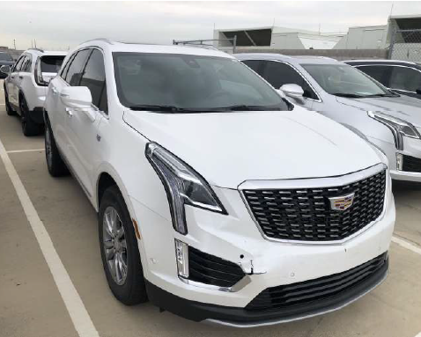
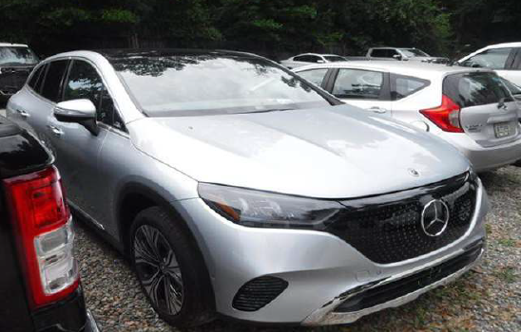
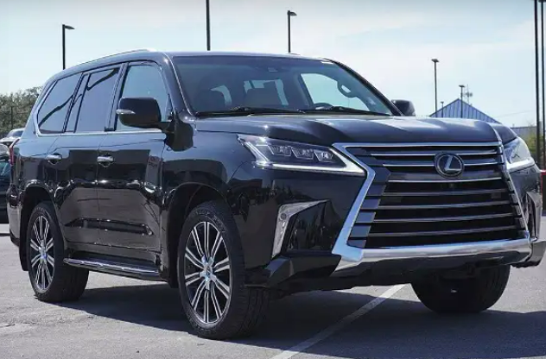
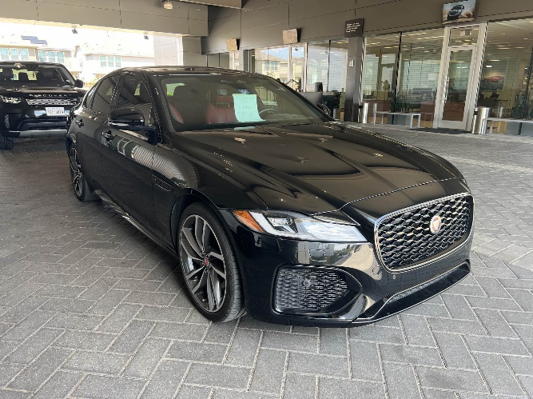
Client Results
+ $9,852 Recovery
+ $5,133 Loss of Use
+ $2,998 More Complete PD
+ $1,721 Total Diminished Value
Cadillac XT5
+ $26,824 Recovery
+ $3,289 Loss of Use
+ $11,557 More Complete PD
+ $11,978 Total Diminished Value
Mercedes-Benz EQE350
+ $15,758 Recovery
+ $2,699 Loss of Use
+ $4,199 More Complete PD
+ $8,860 Total Diminished Value
Lexus LX570
+ $10,540 Recovery
+ $3,000 Loss of Use
+ $3,630 More Complete PD
+ $3,910 Total Diminished Value
Jaguar XF

Slide 4
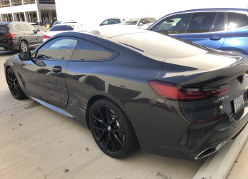
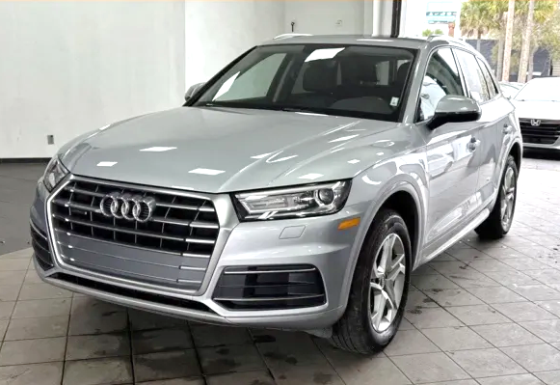
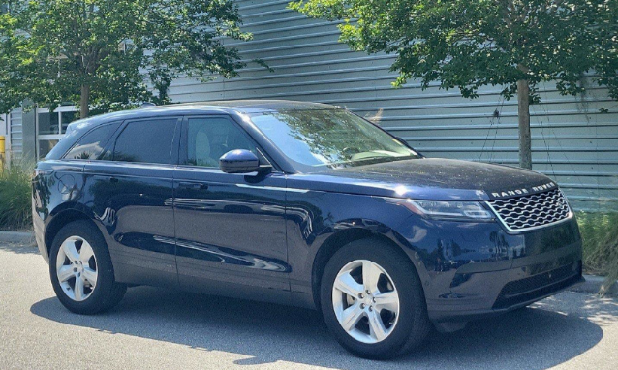
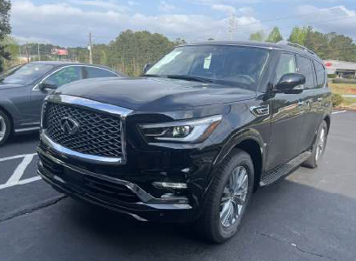
Results
+ $13,962 Recovery
+ $3,250 Loss of Use
+ $1,796 More Complete PD
+ $8,916 Total Diminished Value
BMW 840i
+ $8,268 Recovery
+ $2,250 Loss of Use
+ $2,595 More Complete PD
+ $3,423 Total Diminished Value
Audi Q5
+ $12,714 Recovery
+ $2,039 in Loss of Use
+ $5,297 More Complete PD
+ $5,378 Total Diminished Value
Land Rover Range Rover Velar P250
+ $26,252 Recovery
+ 3,191 in Loss of Use
+ $14,257 More Complete PD
+ $8,804 Total Diminished Value
Infiniti QX80

Slide 5


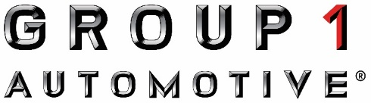

















Clients Include:

Slide 6
Other Benefits
You will receive more complete recoveries than internal teams or TPAs produce.
You will save significant time, effort, and cost by letting us do the work.
You will never write us a check; we take a percentage of “found” value recovered.
You can be up and running in an hour; we have this down to a science.
You have everything we need to pursue claims…it is not a lot of work.
You will see that our Terms of Service are simple, fair and transparent.
You can stop using us at any time if you are unhappy for any reason.
You will have a seamless process with respect to internal teams and TPAs.
Advances against qualified claims can be available to speed up cash flow.
Claims ACM pursues are not filed as losses with your insurance. No rate impact.
Your people will love us once they work with us and see the results.
You can see the progress of every claim in our Tracker portal.
You can rely on periodic account reviews and timely support as needed.
You can count on 28 years of ACM expertise doing this one thing very well.
“I work regularly with ACM on a variety of vehicles. The process is straight forward, easy to understand, and implement. Everyone there is always willing to help with questions and support when needed. It is a pleasure to do business with ACM.”
Guy Cunningham, Penske Automotive Group
“ACM has always displayed high level of attention to details, efficiency and professionalism in handling our account. What makes ACM stand out from our TPA is how efficient you guys are when it comes to communication. Whether it’s phone call or email, we can always count on ACM to respond with details and on time.”
Victoria Mamkwe, Friedkin Group, Inc.

