Slide 1
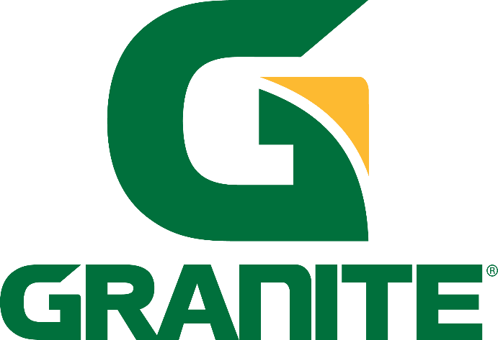
Not-at-Fault Damage Recovery Program
P r e p a r e d F o r :
P r e p a r e d B y :
Amanda Tierney Granite Construction Watsonville, CA
amanda.tierney@gcinc.com
Elise Brunson
Alternative Claims Management
San Antonio, TX
ebrunson@altclaim.com

Slide 2
How We Help
ACM specializes in nationwide recovery for specialty fleet vehicles, including construction, trucking, utilities, buses, trade services, EMS, police, fire, and more. We secure maximum value for not-at-fault accident claims, including repairs, lost revenue, loss of use, market value, damaged equipment, and total losses – funds rightfully yours.
Key Advantages:
More complete recovery
Not a budgetary add; no upfront costs or risks
Huge labor savings for your staff; recover valuable time for more important tasks
Proven results: over $80 million returned annually to clients
Claims audit for the past 2-10 years (varies by state)
Claim Line Items We Recover:
Physical Damage (PD): Recovery of losses up to the value of the Client’s final repair invoice or original body or mechanical shop estimate.
Physical Damage (PS) – Photoscopes Only. ACM may accept clear photographs from which an independent, third-party appraiser can prepare an estimate. This reduces Client’s downtime, labor associated with estimate collection, and keeps fleet vehicles in service.
Loss of Use (LOU): The rental value of a comparable replacement vehicle or equipment for the days the unit is anticipated to be out of service for repair or replacement.
Loss of Revenue (LOR): The estimated loss of income while the vehicle is out of service.
Inherent Diminution of Value (DV): The estimated variance of the vehicle pre-accident and the repaired vehicle post-accident.
Repair Related Diminution of Value (RRDV): The difference between the Client’s actual repair invoice versus an estimate written to I-CAR/Manufacturer Design and Repair Specifications (OEM).
Total Loss (TL): The difference between the vehicle’s Actual Cash Value (ACV) and one of these valuation methods: Depreciated Book Value, Wholesale Value, Depreciated Value, Mutually Agreed Upon Value.
Recovered Fees (RF). Paid by the At-Fault Party’s Carrier. These are fees associated with processing or repairing the vehicle; administrative, sanitation, content removal, and other fees charged to the carrier.
Other Property Damage (OPD): In cases where property damages are incurred apart from the vehicle itself but are causally related to the event causing the damages, ACM will include these additional items. This may include, but not be limited to, all types of signs, guard rails, lights/light poles, buildings, goods in transit, and other non-vehicle equipment owned by Client and damaged in the event. It might also include towing and storage fees.

Slide 3
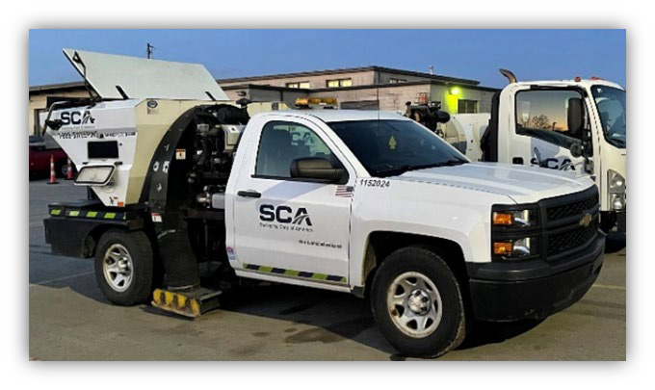

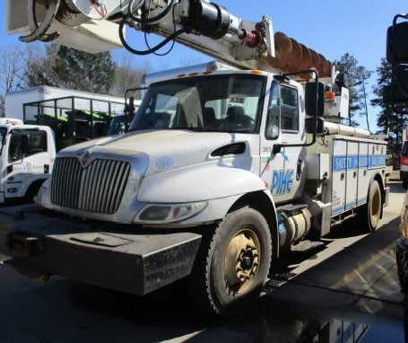

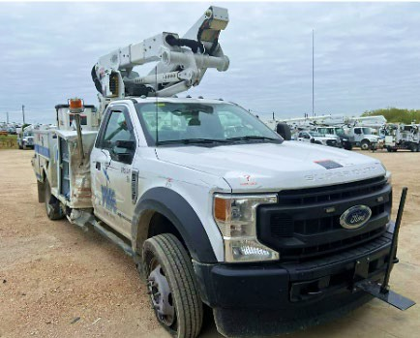

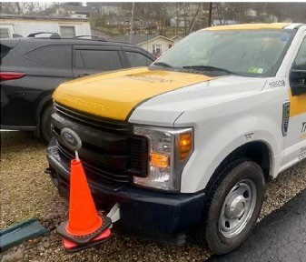

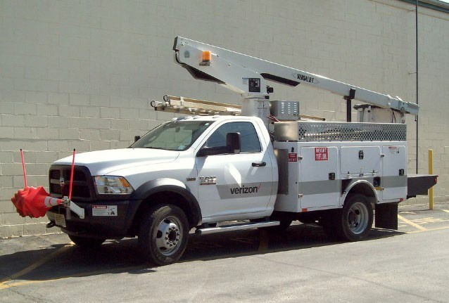
Results
$31,475 in Loss of Use
$8,354 in Physical Damage
+$5,298 in Diminished Value Chevy Silverado Street Sweeper
$13,125 in Loss of Use
$14,688 in Legal Fees/Material Cleanup
$10,964 in Physical Damage
International MA025 Work Truck
$9,925 in Loss of Use
+ $890 in Diminished Value
$19,667 in Physical Damages
Ford F-550 Super Duty Chassis
$9,675 in Loss of Use
$8,829 in Physical Damages
Ford F-350 Work Truck
$7,150 in Loss of Use
$3,209 in Physical Damages
11 days of downtime
Ford F-250 Bucket Truck

Slide 4
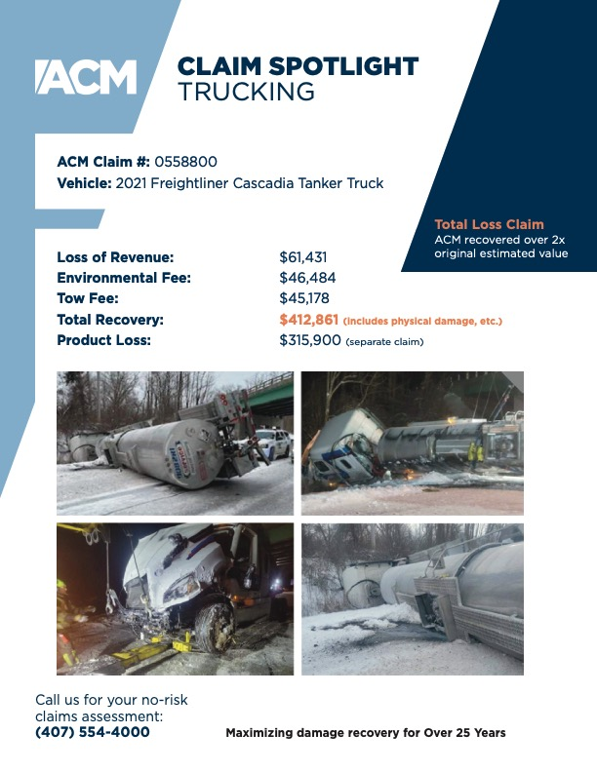
Photoscope & Asset Recovery
The Photoscope Program is set up to help fleet owners capture and recover minor cosmetic damages that are not sufficient enough to remove a vehicle from service for a repair estimate.
Using photos and the incident and/or police report, ACM can produce an appraisal in-house using qualified vendor relationships and still recover the damages that were not pursued. Depending on your recordkeeping, we can go back several years up to the state statute of limitations and recover for those damages and anticipated downtime.
Uncollected damages can be recovered from previously worked files to include loss of use and diminution of value as circumstances permit.

Slide 5




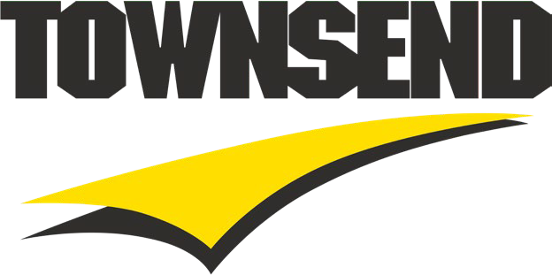






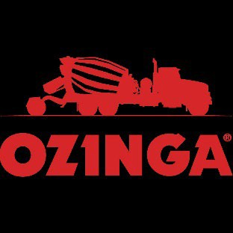
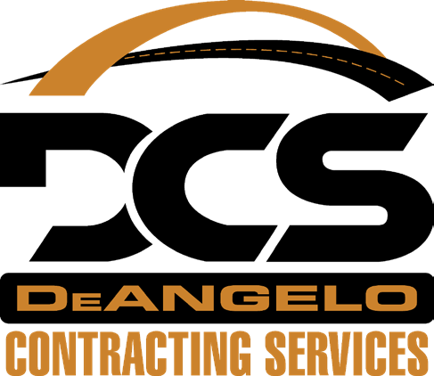









Our Clients Include

